Slide 1

Modern Education Society’s Wadia College OF Engineering, Pune – 14 ACCREDITED BY NBA AND NAAC WITH A ++ GRADE A.Y.: 2025-26
RESEARCH INTERNSHIP
“Result Analysis”
Guided By : Dr. Shilpa P. Khedkar
Presentation By:
Harshavardhan Gharal (F23112049)
Sahil Dhanwade (F23112076)
Shweta Korekar (F23112027)

Slide 2
INTRODUCTION
The Result Analysis System is designed to automate the process of extracting and analyzing student result data from PDF files. Traditionally, this task is performed manually, which is time-consuming and prone to errors. This system converts unstructured PDF data into a structured Excel format and generates meaningful insights such as topper, average performance, and subject-wise analysis. It improves accuracy, reduces manual effort, and enables faster and more efficient decision-making in educational institutions.

Slide 3
Problem STATEMENT
Educational institutions often store student results in PDF or ledger formats, which are not suitable for direct analysis. Converting this data into a structured format requires manual effort, which is time-consuming and prone to errors. There is a need for an automated system that can extract, organize, and analyze result data efficiently, reducing manual work and improving accuracy.

Slide 4
Objective
Convert result PDF into structured Excel format
Automate data extraction and reduce manual work
Improve accuracy and eliminate human errors
Analyse student performance (topper, average, etc.)
Generate subject-wise insights
Provide a simple and user-friendly interface

Slide 5
Existing vs Proposed System
❌ Existing System
Manual data entry from PDF to Excel
Time-consuming and repetitive process
Difficult to analyze large data
No proper visualization or dashboard
Slow decision-making
✅ Proposed System
Automatic data extraction from PDF
Fast and efficient processing
Accurate and reliable results
Easy analysis of large datasets
Dashboard with graphs and insights
Quick and better decision-making

Slide 6
Methodology
Collect result data from PDF files
Extract student details and marks using Python
Clean the data (remove errors, missing values)
Convert data into structured tabular format
Store data in Excel file
Perform analysis (topper, average, subject-wise)
Generate graphs and insights
Display results on dashboard

Slide 7
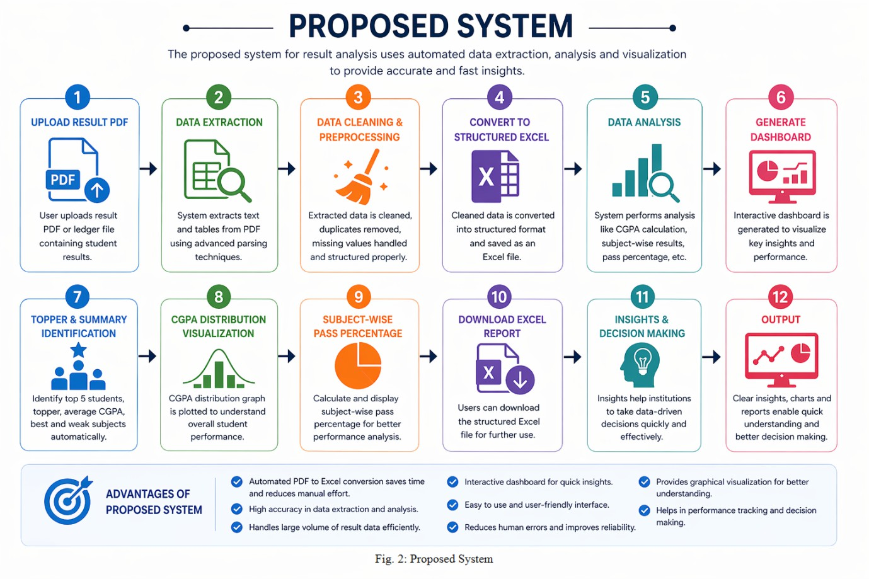
System Architecture

Slide 8
Technologies Used
Python – Core programming language
pdfplumber – Extract data from PDF files
Pandas – Data processing and analysis
NumPy – Numerical operations
Matplotlib – Data visualization (graphs)
OpenPyXL – Excel file handling
Tkinter – GUI development

Slide 9
RESULTS
Successfully converted PDF result data into Excel format
Accurate extraction of student details and marks
Generated insights like topper, average CGPA, and subject analysis
Displayed results through a user-friendly dashboard
Visualized data using graphs (CGPA distribution)
Reduced manual effort and improved efficiency

Slide 10
Challenges Faced
Handling different PDF formats and layouts
Extracting accurate data from unstructured files
Managing missing or inconsistent data
Designing efficient regex for data extraction
Integrating backend processing with GUI
Ensuring accuracy in analysis results

Slide 11
Applications
Used in colleges for result analysis and reporting
Helps teachers evaluate student performance quickly
Useful for generating automated reports and insights
Can be integrated into academic management systems
Supports data-driven decision making in education
Can be extended to other data analysis applications

Slide 12
Future Scope
Develop a web-based or mobile application
Support multiple PDF formats and universities
Add advanced data visualization and analytics
Integrate with college database systems
Enable real-time result processing
Use AI/ML for deeper performance analysis

Slide 13
CONCLUSION
The Result Analysis System successfully automates the process of converting result data from PDF files into a structured Excel format. It generates meaningful insights such as topper identification, subject-wise performance, and graphical analysis. The system reduces manual effort, improves accuracy, and provides a user-friendly interface for easy use. Overall, it offers an efficient solution for faster and more effective result analysis in educational institutions.

Slide 14
REFRENCES
Python Official Documentation – https://www.python.org
Pandas Documentation – https://pandas.pydata.org
NumPy Documentation – https://numpy.org
Matplotlib Documentation – https://matplotlib.org
OpenPyXL Documentation – https://openpyxl.readthedocs.io
pdfplumber Documentation – https://github.com/jsvine/pdfplumber
W3Schools Python Tutorial – https://www.w3schools.com/python/

Slide 15
THANKS!!!!!

